Slide 1
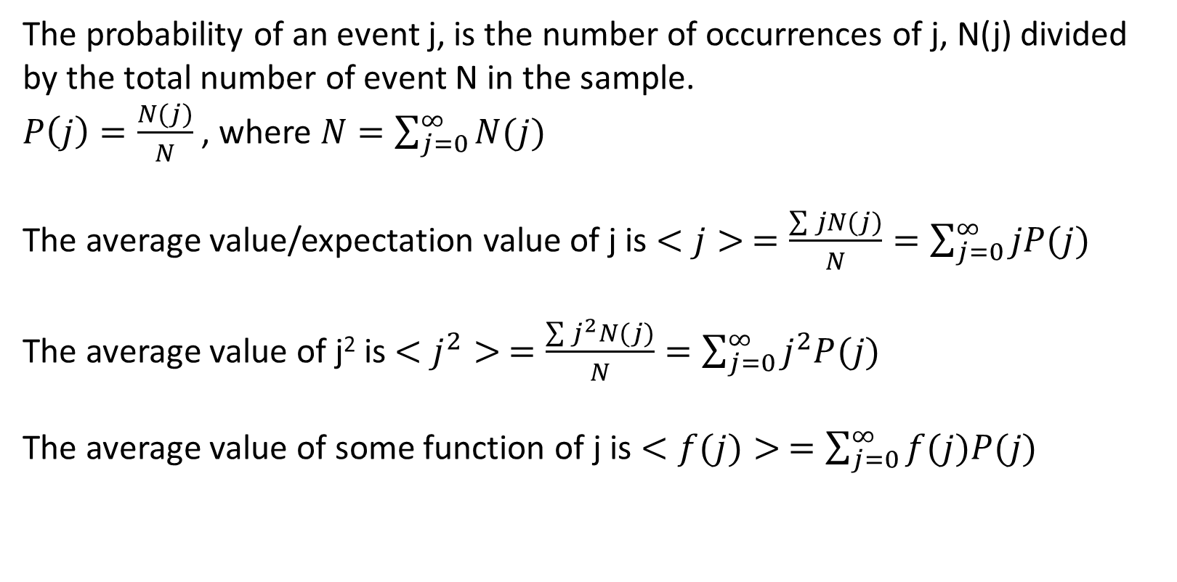
Probability
The probability of an event j, is the number of occurrences of j, N(j) divided by the total number of event N in the sample.
$P\left(j\right)=\frac{N(j)}{N}$ , where $N=\sum_{j=0}^{∞}{N(j)}$
The average value/expectation value of j is $<j> =\frac{\sum{jN(j)}}{N}=\sum_{j=0}^{∞}{jP(j)}$
The average value of j² is $<j^{2}> =\frac{\sum{j^{2}N(j)}}{N}=\sum_{j=0}^{∞}{j^{2}P(j)}$
The average value of some function of j is $<f(j)> =\sum_{j=0}^{∞}{f(j)P(j)}$

Slide 2


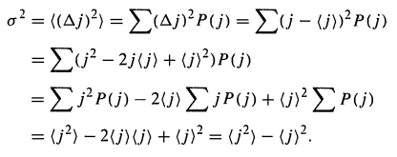
The deviation of j from the mean value $<j>$ is $∆j=j− <j>$
The standard deviation $σ$ can be defined as

Slide 3
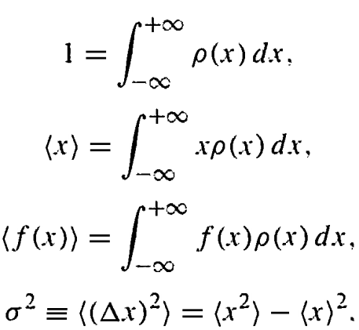
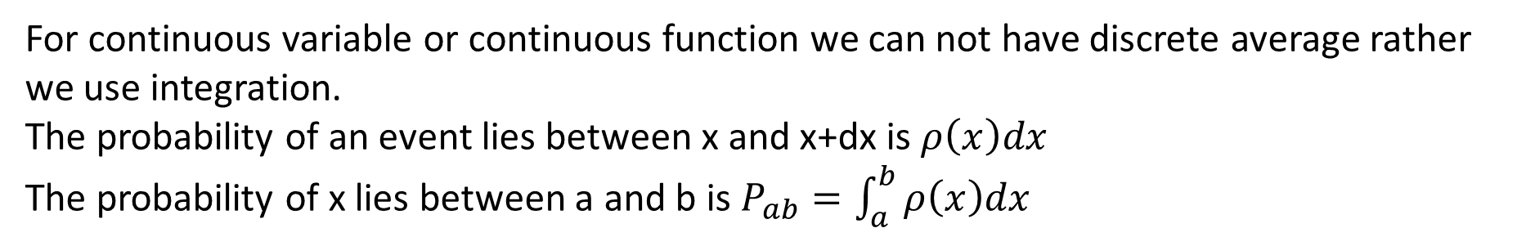
For continuous variable or continuous function we can not have discrete average rather we use integration.
The probability of an event lies between x and x+dx is $ρ\left(x\right)dx$
The probability of x lies between a and b is $P_{ab}=\int_{a}^{b}{ρ\left(x\right)dx}$

Slide 4
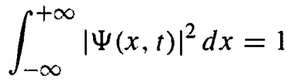
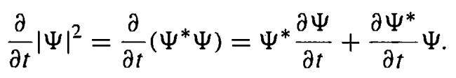
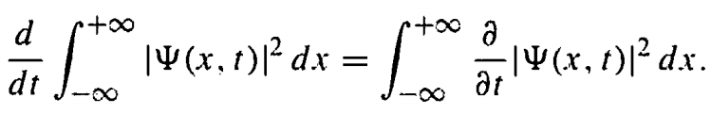
Normalization
The total probability of to find a particle from $−∞$ to $+∞$ should be one. This is the normalization condition:
If a wavefunction is normalizable at t=0, it will be normalizable at any other time
PROOF:

Slide 5
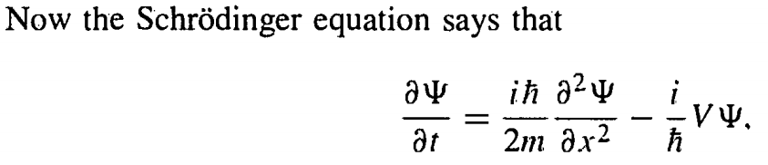
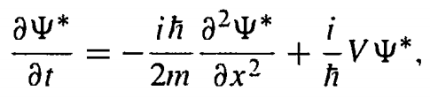
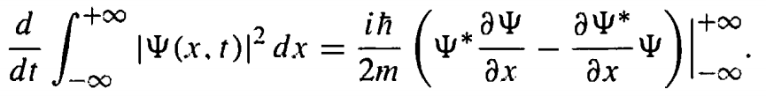

Slide 6
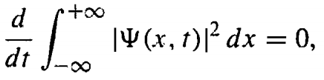

Slide 7
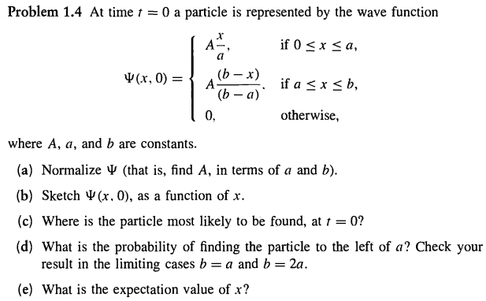

Slide 8
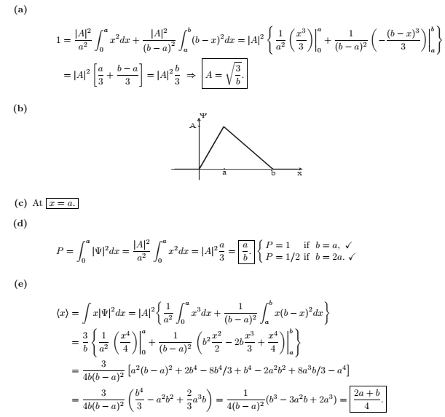

Slide 9
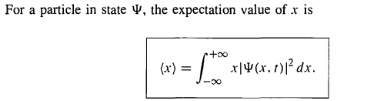
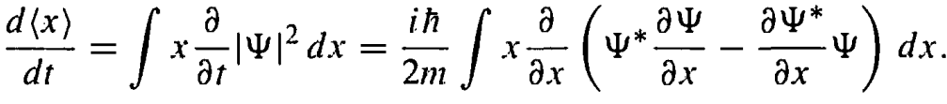
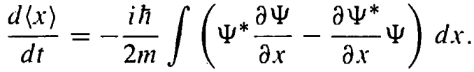
Momentum
As the time goes on the expectation value of x, $<x>$ will change, since $Ψ\left(x,t\right)$ changes with time

Slide 10
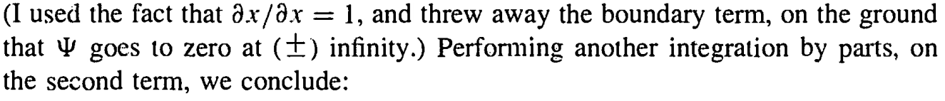
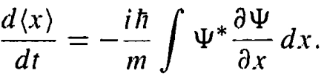
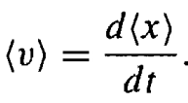
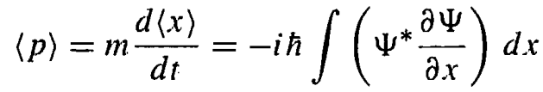
So, the expectation value of the velocity is
And the momentum of the particle is

Slide 11
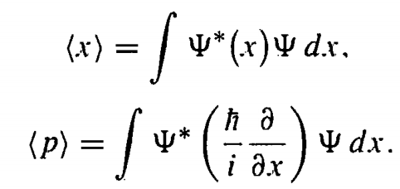
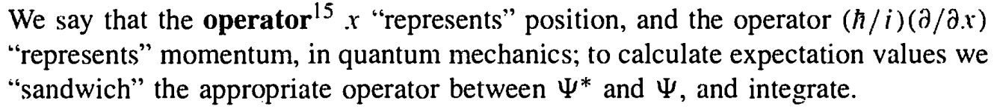
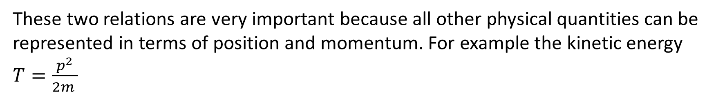
So, the expectation value of the position and momentum of the particle is
These two relations are very important because all other physical quantities can be represented in terms of position and momentum. For example the kinetic energy $T=\frac{p^{2}}{2m }$

Slide 12
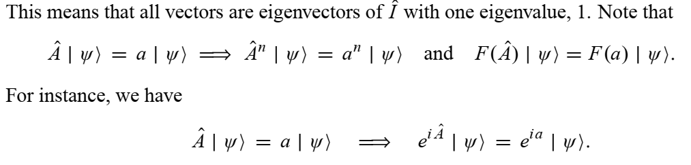
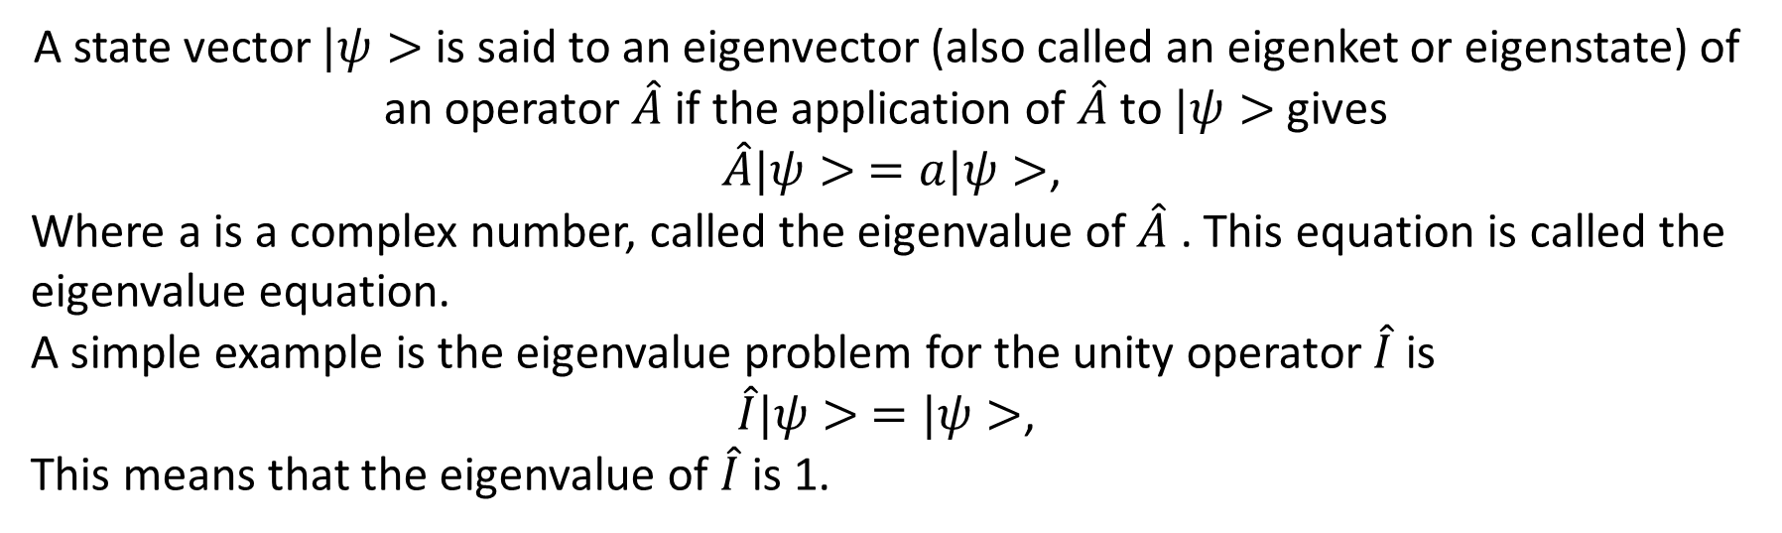
Eigenvector and Eigenvalue
A state vector $|ψ>$ is said to an eigenvector (also called an eigenket or eigenstate) of an operator $\hat{A}$ if the application of $\hat{A}$ to $|ψ>$ gives
$\hat{A}|ψ> =a|ψ>$,
Where a is a complex number, called the eigenvalue of $\hat{A}$ . This equation is called the eigenvalue equation.
A simple example is the eigenvalue problem for the unity operator $\hat{I}$ is
$\hat{I}|ψ> =|ψ>$,
This means that the eigenvalue of $\hat{I}$ is 1.

Slide 13
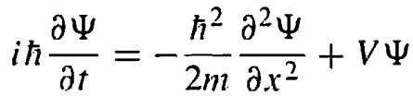
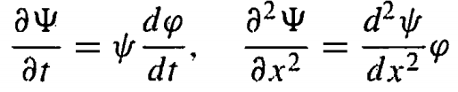
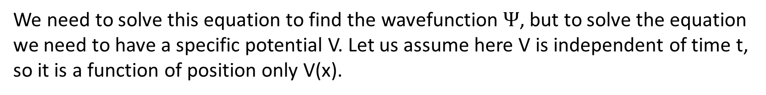
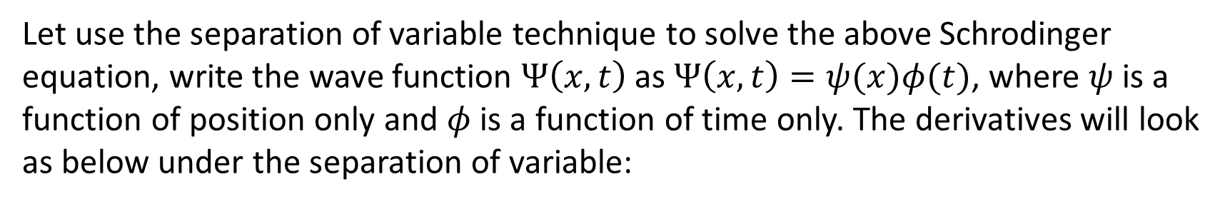
The Schrodinger equation is
We need to solve this equation to find the wavefunction $Ψ$, but to solve the equation we need to have a specific potential V. Let us assume here V is independent of time t, so it is a function of position only V(x).
Let use the separation of variable technique to solve the above Schrodinger equation, write the wave function $Ψ\left(x,t\right)$ as $Ψ\left(x,t\right)=ψ(x)φ(t)$, where $ψ$ is a function of position only and $φ$ is a function of time only. The derivatives will look as below under the separation of variable:

Slide 14
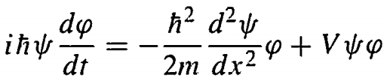
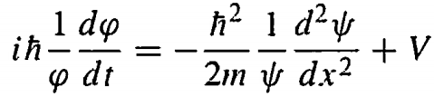
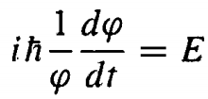
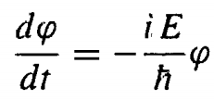
So, the Time-dependent Schrodinger equation looks like
Dividing both side of the above equation by $ψφ$ we get:
Now the left side of the above equation is a function of t alone and the right side is a function of x alone. The only way the above equality is true if both sides are constant, otherwise if one change t, the x will not change and the equality will not hold anymore. So we can write
or
(1)

Slide 15
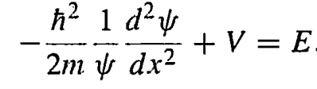
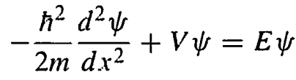
And the Schrodinger equation becomes
or
(2)
So, the separation of variable method converts the Schrodinger equation (the partial differential equation) into two ordinary differential equations
(1) and (2) of single variable. Equation (2) is called the time-independent Schrodinger equation.
Equation (1) is easy to solve, and the solution is $φ=e^{−iEt/ℏ}$(check!!)
So, the original wavefunction now looks like $Ψ\left(x,t\right)=ψ(x)e^{−iEt/ℏ}$

Slide 16
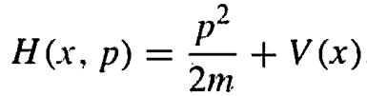
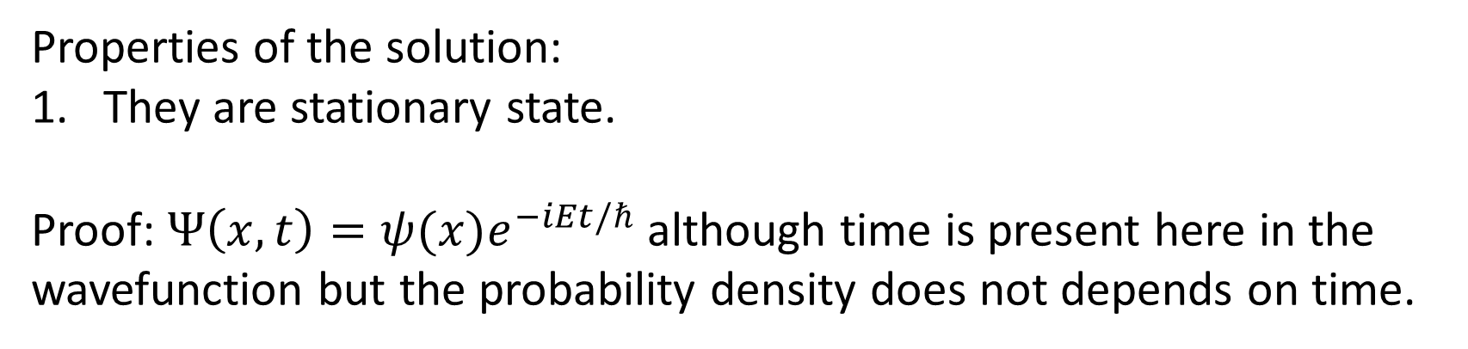
Properties of the solution:
They are stationary state.
Proof: $Ψ\left(x,t\right)=ψ(x)e^{−iEt/ℏ}$ although time is present here in the wavefunction but the probability density does not depends on time.
2. They are definite total energy states.
Proof: In classical mechanics the total energy is called the Hamiltonian

Slide 17

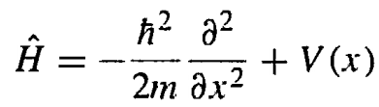

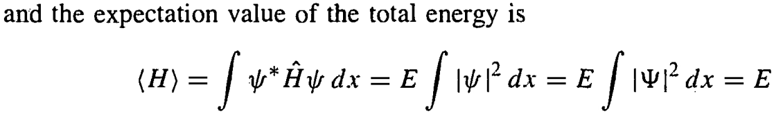
In quantum mechanics the corresponding Hamiltonian operator can be obtain by writing P in the operator form
Thus, the time independent Schrodinger equation (2) become

Slide 18
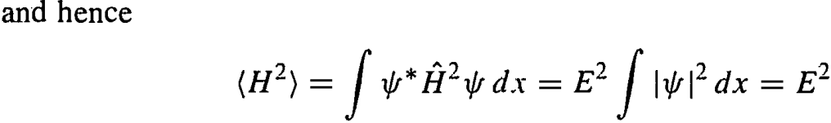
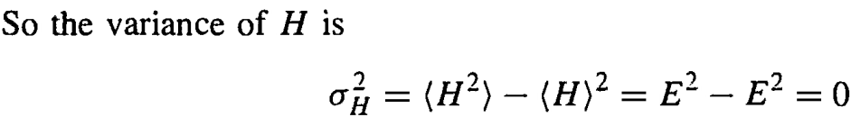

Moreover
We know that, if $σ=0,$ then every member of the sample must share the same value. So, the separable solution has the property that every measurement of the total energy is certain to return the value E.

Slide 19
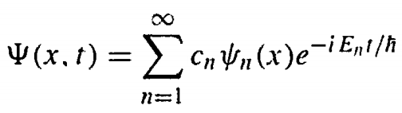
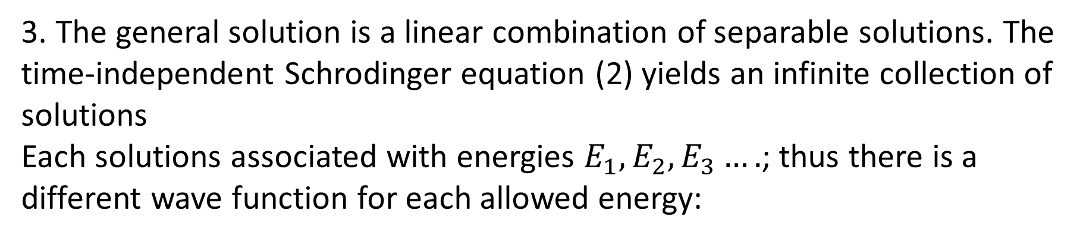
3. The general solution is a linear combination of separable solutions. The time-independent Schrodinger equation (2) yields an infinite collection of solutions
Each solutions associated with energies $E_{1}, E_{2}, E_{3}….$; thus there is a different wave function for each allowed energy:
Once we have separable solution, we can immediately construct the solution of the time-dependent Schrodinger equation as

Slide 20
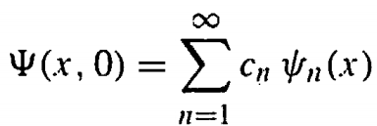
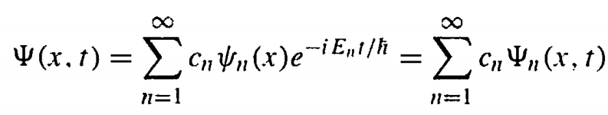
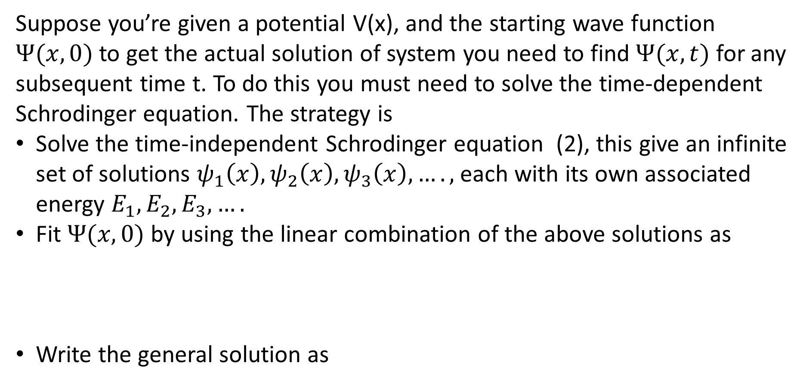
Suppose you’re given a potential V(x), and the starting wave function $Ψ(x,0)$ to get the actual solution of system you need to find $Ψ(x,t)$ for any subsequent time t. To do this you must need to solve the time-dependent Schrodinger equation. The strategy is
Solve the time-independent Schrodinger equation (2), this give an infinite set of solutions $ψ_{1}\left(x\right), ψ_{2}\left(x\right),ψ_{3}\left(x\right),….,$each with its own associated energy $E_{1}, E_{2},E_{3},….$
Fit $Ψ(x,0)$ by using the linear combination of the above solutions as
Write the general solution as

Slide 21
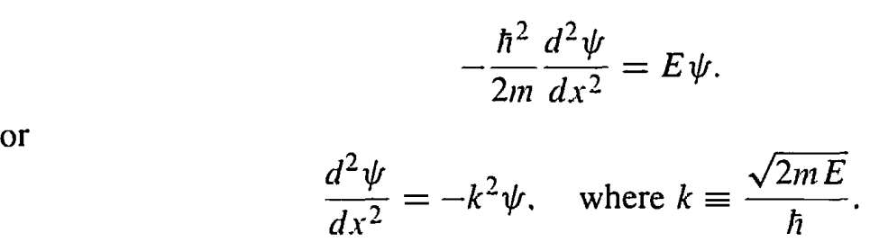

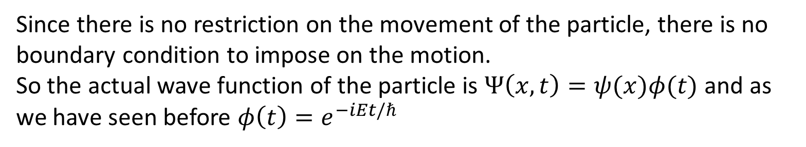
The Free Particle
If a particle moves in a force-free field that means the potential V=0,
So, the time-independent Schrodinger equation become:
The equation looks like the differential equation of a classical harmonic oscillator, whose solution is
Since there is no restriction on the movement of the particle, there is no boundary condition to impose on the motion.
So the actual wave function of the particle is $Ψ\left(x,t\right)=ψ(x)φ(t)$ and as we have seen before $φ\left(t\right)=e^{−iEt/ℏ}$

Slide 22

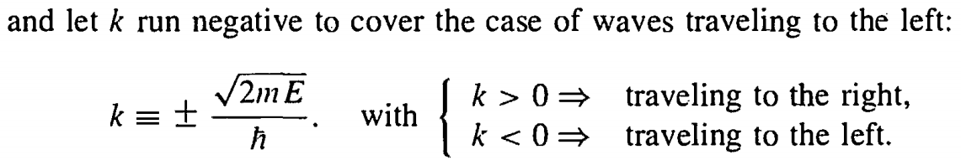

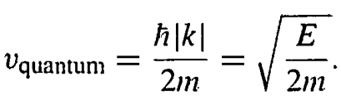
Since the exponent differs only in sign, so one can write
So, the solution of free particle is a propagating wave with the wavelength $λ=\frac{2π}{k}$
According to the de-Broglie the momentum of the particle is
So, the speed of the wave is

Slide 23



The classical speed of a free particle with energy E is given by
$$E=\frac{1}{2}mv^{2}⇒v_{classical}=\sqrt{\frac{2E}{m}}=2v_{quantum}$$
This is not reasonable!!
There is another issue, the normalization of the wave function is
So, it is not normalized!!
The actual solution of the Schrodinger equation should be a linear combination of continuous variable k, so this can be consider as

Slide 24



The factor $φ\left(k\right)$ can be calculated by the following Fourier transformation
The trick is:
You are given an initial wave function $Ψ(x,0)$
You calculate $φ(k)$ by the above relation
By using $φ(k)$ you calculate $Ψ(x,t)$ by the relation

Slide 25


Why did we get the wrong speed of the wave?
A wave packet is a superposition of sinusoidal functions whose amplitude is modulated by $φ$, it consists of ripples within an envelope. The velocity of the ripple is called the phase velocity. And the particle velocity is not the velocity of the ripple it is the velocity of the envelope, called the group velocity. The group velocity can be equal to, less than, or greater than the phase velocity depending on the nature of the medium.

Slide 26




The Infinite Square Well Potential
Suppose
A particle in this potential is completely free, except at the two ends (x=0, and x=a), where an infinite force prevents it from escaping. A classical model would be a cart on a frictionless horizontal air track, with perfectly elastic bumpers-it just keeps bouncing back and forth forever.
Outside the well, the probability of finding the particle is zero so $ψ\left(x\right)=0.$ Inside the well, V=0, so the time-independent Schrodinger equation become

Slide 27




(3)
Equation (3) is similar to the equation of a classical simple harmonic oscillator.
The general solution of the above equation is
Where A and B are arbitrary constants whose value needs to be determined from the boundary condition.
So

Slide 28





Slide 29




(4)
Equation (4) is the solution of wave function for a square well potential. It is a set of solution,

Slide 30




The solution $ψ_{1}$is called the ground state solution, $ψ_{2}$ is the 1st excited state, $ψ_{3}$ is the 2nd excited state, and so on.
Properties of $ψ_{n}(x)$

Slide 31


Proof:
The normalization and orthogonalization can be done in a single statement as follows:

Slide 32



Slide 33




The coefficients $C_{n}$ can be evaluated for a given $f(x)$ by multiplying both side of the above equation by $ψ_{m}{(x)}^{∗}$ and integrating
Which gives
The stationary states of the infinite square well can now be written as:
The most general solution to the time-dependent Schrodinger equation is a linear combination of stationary states:

Slide 34



Problem
A particle in the infinite square well has the initial wave function
$Ψ\left(x,0\right)=Ax\left(a−x\right), (0≤x≤a)$
for some constant A. Outside the well$Ψ=0$ , Sketch the wave function. Find $Ψ\left(x,t\right)$

Slide 35



So,
Now we need to find $C_{n}$ for the wave function

Slide 36



The Harmonic Oscillator Potential
For the quantum harmonic oscillator, the potential is of the type
Where
We need to solve the Schrodinger equation of the form
(1)

Slide 37



Let us rewrite equation (1) as
(2)
So the Hamiltonian operator H can be written as
Let us define the quantity
(3)

Slide 38



Here the term (xp-px) is called the commutation of x and p the position and momentum operator.
In the commutation relation we can write
(3)

Slide 39



Which give
This relation is known as canonical commutation relation.
Equation (3) now become
(4)
(5)

Slide 40




Similarly, we can have
(6)
And
(7)
So, the operator a has the properties
The Schrodinger equation (1) become
(8)

Slide 41


Now if $ψ$ satisfies the Schrodinger equation with energy $E$, then $a_{+}ψ$ satisfies the Schrodinger equation with energy $\left(E+ℏω\right).$ That is
Proof:

Slide 42



Slide 43




If we apply the lowering operator repeatedly eventually, we will reach a state with energy zero, which does not exist! So there is a lower value $ψ_{0}$ for which $a_{−}ψ_{0}=0$. So, from equation (3) we can write
(9)

Slide 44


(10)

Slide 45




To determine the energy of this state we plug it into the Schrodinger equation (8) as,
We must use the fact that $a_{−}ψ_{0}=0$

Slide 46

The Bound States and Scattering States
In classical mechanics a one-dimensional time-independent potential can give rise to two rather different kinds of motion.
If V(x) rises higher than the particle’s total energy (E) on either side, then the particle is stuck in the potential well- it rocks back and forth between the turning points, but it cannot escape. We call this a bound state.

Slide 47



If E exceeds V(x) on one side (or both), then the particle comes in from infinity, slows down or speeds up under the influence of the potential, and returns to infinity. We call this a scattering state.
In “real life” most potentials go to zero at infinity, in which case

Slide 48





The Delta-function Potential

Slide 49





Slide 50





The boundary conditions of the wave function are

Slide 51




Now we need to show that the derivative of wave function is continuous everywhere except at x=0, the 2nd boundary condition

Slide 52







Slide 53







Slide 54



The scattering states

Slide 55




Equ (1)

Slide 56






Equ (2)
We are left with two equations (1) and (2) and four unknown A, B, F, and G.

Slide 57




Solving equation (1) and (2) for B and F we find

Slide 58




Slide 59



Slide 60



